Slide 1
Central Government Leadership Development
Trine Dahl
SIG meeting CPH June 2017

Slide 2
DANISH PUBLIC SECTOR – OVERALL VIEW
Central Government
Regional Government
Local Government

Slide 3
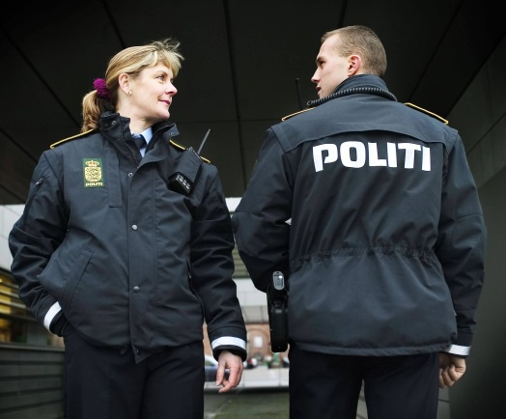
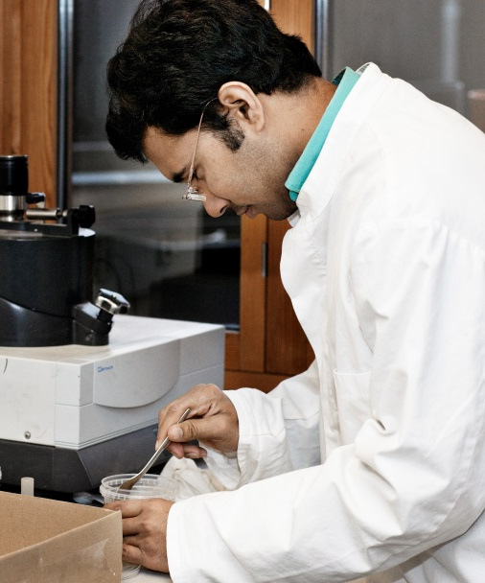
WHY improve leadership?

Slide 4
Program for leadership development (central government)
Initiatives for
specialists
Initiatives for management teams
Networks
Master classes
Preparing for management
Newly appointed managers
Experienced managers
Managers of managers
Topmanager talents
Forum for topmanagers
Talented employees
Newly appointed managers/team managers
Experienced managers
Dep. permanent secretaries/dep. dir. generals
Dep. permanent secretaries/dep. dir. generals
Permanent secretaries/ director generals
E-platform

Slide 5
The Direction of PLUS
Strategic focus and core tasks of the organisations
Crossgovernmental focus areas
Holistic Understanding
Innovation
Reflection
Ability to Act
Professional Leadership

Slide 6
INSPIRATION: A New Synthesis of Public Administration
PERFORMANCE
EMERGENCE
COMPLIANCE
RESILIENCE
Kilde: A Unifying Framework (Jocelyn Bourgon, 2010).

Slide 7
Challenges - balances
In-house ressources/ Purchase of consultants
The role of MOF: Visabilty/Confidential room
Content:
Cross-government focus/ local or personal focus
Tools/theory/training/reflection
First-mover/Stability
Exclusiveness/Broad effect

